Slide 2
Equity Through Co-Design: Identifying System Solutions to Barriers to ECE Enrollment in Cincinnati
Kristen Copeland, MD FAAP
Professor of Pediatrics
October 5, 2023
Notes:
I am honored and frankly quite humbled to be presenting amongst such an esteemed group of speakers and panelists today.
I am Kristen Copeland, a general pediatrician and researcher who sees patients in our primary care pediatric clinics at Cincinnati Children’s Hospital, and I will be sharing some of our findings from work we did with parents and early childhood educators in Cincinnati to understand system barriers to early care & education or ECE program enrollment, and together to begin to solve them.
Next slide

Slide 3
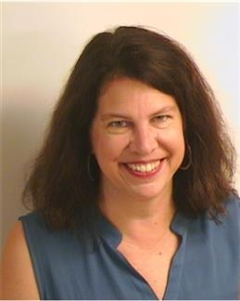
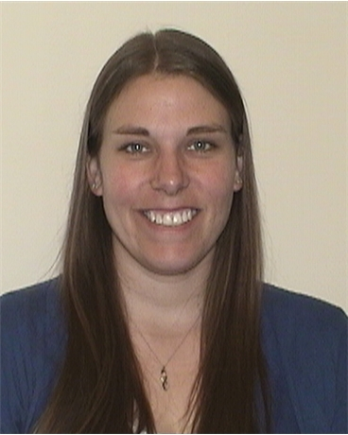
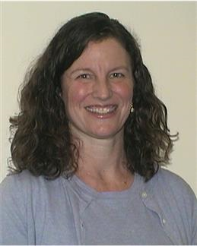
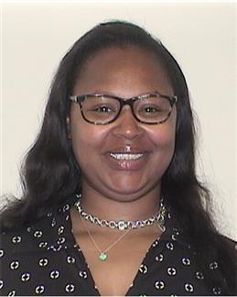
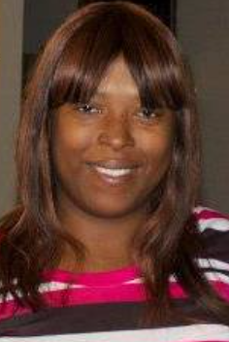
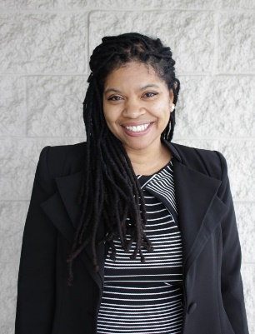
Equity Through Co-Design: Identifying System Solutions to Barriers to ECE Enrollment in Cincinnati
Project Team (n=6) and Peer Researchers (n=16)
Notes:
And I want to highlight that I am speaking on behalf of a large and diverse talented team here of almost two dozen people- some of which are pictured here, including parents, ECE professionals from 12 different programs, and and researchers from Cincinnati Children’s and a social impact firm called Design Impact.
Next Slide

Slide 4
PROJECT GOALS
1
Identify system-level barriers that keep low-income families and families of color from enrolling in high-quality ECE program.
Co-design potential system interventions and prototypes with parents and ECE agency partners.
Use continuous quality improvement methods to test co-designed prototypes across agencies in partnership with families.
2
3
Notes:
We had three main goals in this project, using qualitative, human design, and quality improvement methods, respectively.
First, we sought to identify
Then co-design
Then use continuous QI
Most of my comments today will focus on these co-designed system solutions
Next slide

Slide 5
Discovery, Synthesis, Ideation
Peer Researchers partnered with core team members to conduct:
20
PARENT INTERVIEWS
18 Black/African American, 2 White
and
18 Mothers, 2 Fathers
5
ECE FOCUS GROUPS
18 Early childhood professionals representing 12 different programs in the community
and
5
CREATIVE CONVENINGS
Notes:
A note about our process:
We used peer researchers, which were parents and ECE professionals to conduct 20 parent interviews about barriers to ECE enrollment. Interviews took place on Zoom in April and May of 2020
We were fortunate to be able to conduce 4 in-person trainings with peer researchers in February and March just before the pandemic.
In May and June, we conducted 5 focus groups on Zoom with ECE professionals in the community
And in June through August, we conducted what we called 5 “creative convenings” on Zoom where we synthesized findings from the interviews and focus groups, began to brainstorm possible solutions, and in later sessions began to flesh out and refine these system solutions
Next Slide

Slide 6
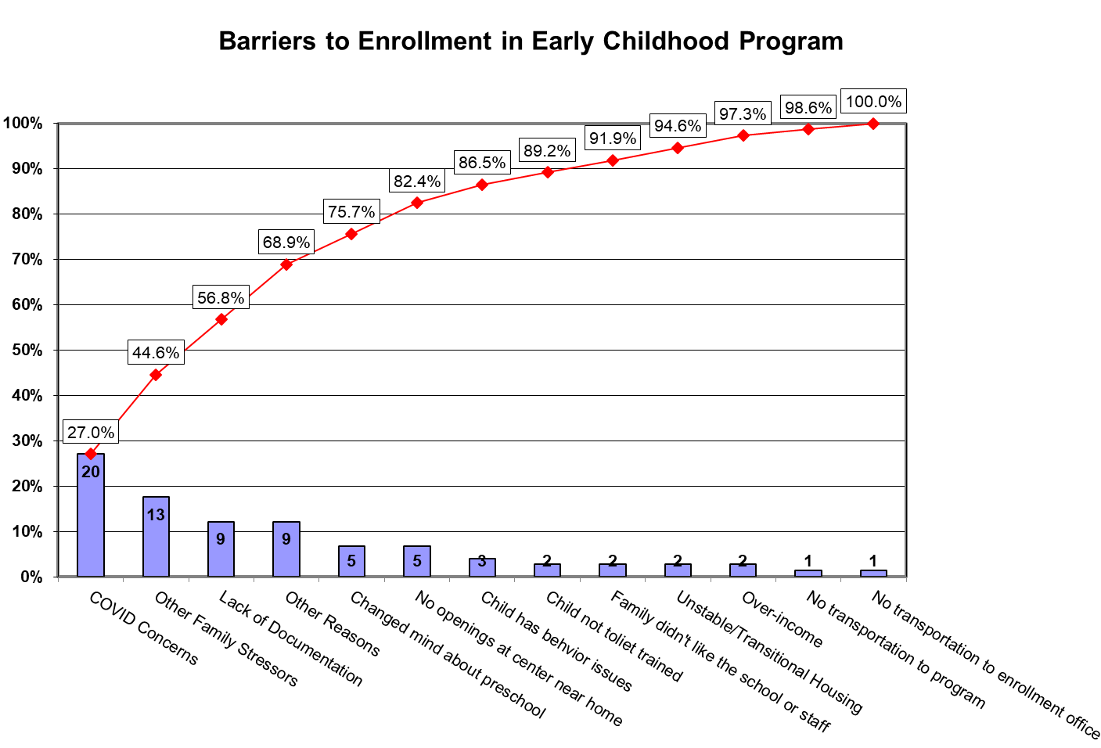
Notes:
This chart is a tool of quality improvement called a Pareto chart, where barriers to a process are listed in decreasing order of prevalence
This Pareto was from the first half of 2020 as an early childhood specialist who works in our general pediatric clinic documented the categories of barriers 74 families faced who were considering or trying to enroll in ECE programs. You will see that COVID concerns topped the list, followed by a catch-all category of “other family stressors” that is common for our patient population, who is primarily insured by Medicaid and often face financial hardships. Lack of Documentation/excessive paperwork was next, followed by another catchall category of “other reasons.” Next was “changed mind about preschool – which could be due to Covid or not liking the vibe of the place, and No openings near the home.
Next Slide

Slide 7
8 SYSTEM CHANGE PROTOTYPES:
1.
2.
2.
ECE Digital Passport
Families First
Concierge/Enrollment Coach (Preschool Realtor)
Universal ECE Application
Equitable Funding
Interactive Enrollment Map
Bridge to Better Campaign
Placeholder One-Pager
2
5.
6.
7.
8.
Notes:
This slide shows our final results from the design work – the system prototypes co-created by parents and ECE professionals.
^{b} All eight solutions were ranked by parent and ECE stakeholders after final creative convening with rankers submitting up to their top five ranked choices For the sake of time, I will just discuss the top 4 solutions, but would be happy to address questions about any of them in the Q & A
The most popular and highly ranked was the ECE digital passport envisioned as a user-friendly, cloud-based resource or app—that would allow families to safely and securely store all the documents needed for enrollment and allow families to decide which agency or agencies receive these documents. the parent maintains control of their personal data and could easily view it, like personal electronic health records such as MyChart.
Tied for 2nd ECE coach or navigator, akin to an ECE real estate agent, who was a non-biased person not affiliated with any ECE program, who could show families their ECE options and help find programs that best match their needs. This was envisioned as sort of a concierge service that families could access via chat or texting, phone calls or in person and after normal business hours when families were doing the search process.
Also tied for 2nd a Universal ECE application – similar to the Common App for college -- standardized application that eliminates the need to complete numerous similar, but slightly different, enrollment applications every time the child needed to change programs, or if the child was unable to secure a spot from the wait list.
And last, tied for 2nd And Equitable Funding - preschool or early education should be free and universal, like K-12 education. Participants felt this would help address inequities in access to high quality ECE experienced by families with low income and families of color
Next slide

Slide 8
BARRIERS / FACILITATORS TO ECE ENROLLMENT
ECE STAFF & PARENT CO-CREATED SOLUTIONS
Enrollment Process
Lack of awareness
Universal Application
Paperwork
ECE Digital Passport
Outdated Technologies
ECE Coach / Navigator
Lack of transparency
Logistics
Searchable Map from mobile platform
Transportation
One-pager Placeholder Application
Cost
COVID - 19
Families First Orientation
Human Factors
Equitable and Increased Funding
Safety & Trust
Diversity
Bridge to Better
Notes:
This slide shows the co-created solutions again in blue the column on the right side, mapping them to the type of barriers they address on the column on the left. Here you can see there were three broad categories of barriers to ECE enrollment brought up in interviews with parents and focus groups with ECE professionals, falling into 3 broad buckets related to enrollment process, logistics, and human factors.
Here is one quote from an interview that sums up several barriers:
“I don’t have a printer so getting the documents printed was a problem. I had to print income verification and proof of where I live. I don’t have quick access to those documents. I had to schedule a time to talk to my property manager. I had to drive all around the city getting medical documents because I couldn’t get them faxed. My barriers were document related.” Parent

Slide 9
THEMES FROM THE WORK
Parent voice guided the learnings throughout the work
ECE agency partners learned about parent perspective in interviewing them, parent peer researchers learned benefits of ECE in working alongside ECE peer researchers
Safe and supported families are foundational, health equity and educational equity are interdependent
Shared barriers, shared measures, and shared learnings built collective will which is now mobilized into collective action
Notes:
Finally, in conclusion, I wanted to highlight two themes on this slide
Parent voice guided the learnings throughout the work (peer researchers, co-design prototypes and interventions, participate in testing, parent lead on teams)
ECE agency partners learned about parent perspective in interviewing them, parent peer researchers learned benefits of ECE in working alongside ECE peer researchers
Thank you for your attention, I look forward to answering your questions during the Q & A.
Let me introduce our next speaker, Meghan McCormick

Slide 10
Factors Driving Equitable Access to High-Quality Pre-K:
Answering Critical Questions by Disaggregating Who, What, When, and Where
Meghan McCormick, MDRC
Christina Weiland, University of Michigan
JoAnn Hsueh, MDRC
Cullen MacDowell, MDRC
JoAnn Hsueh, MDRC
Samuel Maves, MDRC
Samantha Xia, MDRC
Anne Taylor, University of Michigan
Jason Sachs, Boston Public Schools (now BMGF)
Strategies to Strengthen Equitable Access and Participation
in Early Care and Education Webinar
October 5th, 2023
Notes:
In partnership with Boston Public Schools, University of Michigan and Harvard Graduate school of Education, we are currently working on a study that aims to explore and describe children’s experiences from PreK to third grade. I’d like to thank all the people participating in this study and helping in the development of this research – should I name everyone and say their institution as well?

Slide 11
Policy questions related to PreK access and equity in universal early childhood systems
Who?
Who enrolls in universal programs?
What?
Does access to high-quality PreK vary across groups?
When & Where?
How do structural factors – like proximity- affect access over time for different groups?

Slide 12
Current study goals: Use Boston Public Schools district data from 2012 – 2018 to promote more equitable access to high-quality prekindergarten
Document differential access to prekindergarten & high-quality prekindergarten across time by race/ethnicity, family income, and DLL status
Understand how proximity to BPS prekindergarten and prekindergarten in high-quality schools varies by race/ethnicity, family income, and home language
Examine how and whether associations between proximity and enrollment in prekindergarten are more salient for students from different backgrounds and across time

Slide 13
Enrollment in BPS prekindergarten program
All children who turn 4 by 9/1 are eligible to apply
Families rank up to 10 schools and a lottery is used to assign slots in oversubscribed schools
A little more than half of the students who enroll in public K also apply to the prekindergarten program
Notes:
Our research site is Boston (Boston Public Schools - BPS).
BPS is a unique site to do this research because they have a strong PreK program. Free, full-day slots are available to 4-year-old students in public schools, while CBOs also have the BPS PreK model implemented with a lot of support from the district.
We randomly selected 20 public schools and 10 CBOs to participate in the study. Classrooms were randomly selected within schools and students within classrooms.

Slide 14
Disaggregation of students by race, ethnicity, family income, and home language in BPS administrative data
Race and ethnicity
Parents report on race and ethnicity using Census questions
Hispanic: this category is prioritized and students are coded as Hispanic if their parent reports this in the ethnicity question.
Black, White, Asian: If the parent reports one race within these groupings, children fall into that category
Other race: If the parent reports more than one race, or the parent reports that the child is Native American/Alaska Native, or Native Hawaiian/Pacific Islander the child is coded as “other race.”
Socioeconomic status
Coded as eligibility for free- or reduced-price lunch
Dual Language Learner status (DLL)
Coded as “DLL” if child speaks a language other than English at home or lives with parent who speaks a language other than English

Slide 15
BPS prekindergarten program & process for enrollment
BPS kindergarten enrollees from 2013 - 2018
N = 22,469 students
BPS prekindergarten enrollees from 2012 – 2017
Analysis sample: N = 12,332 students
Full sample: N = 15,411 students
Full sample: N = 28,904 students
Notes:
Our research site is Boston (Boston Public Schools - BPS).
BPS is a unique site to do this research because they have a strong PreK program. Free, full-day slots are available to 4-year-old students in public schools, while CBOs also have the BPS PreK model implemented with a lot of support from the district.
We randomly selected 20 public schools and 10 CBOs to participate in the study. Classrooms were randomly selected within schools and students within classrooms.

Slide 16
Results

Slide 17
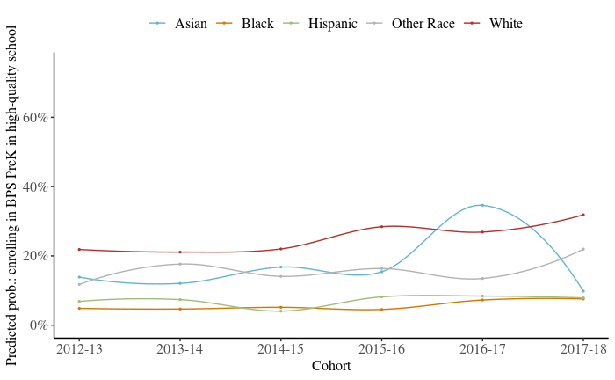
RQ 1: Increasing racial/ethnic disparities in access to BPS prekindergarten in a higher-quality school

Slide 18
RQ 2: Variation in proximity to BPS prekindergarten and prekindergarten in a higher-quality school from 2012 – 2018 by race/ethnicity, family income, and DLL status
Notes:
In general – proximity has increased over time but it looks like White students have benefited most.

Slide 19
RQ 2: Variation in proximity to BPS prekindergarten and prekindergarten in a higher-quality school from 2012 – 2018 by race/ethnicity, family income, and DLL status
Notes:
In general – proximity has increased over time but it looks like White students have benefited most.

Slide 20
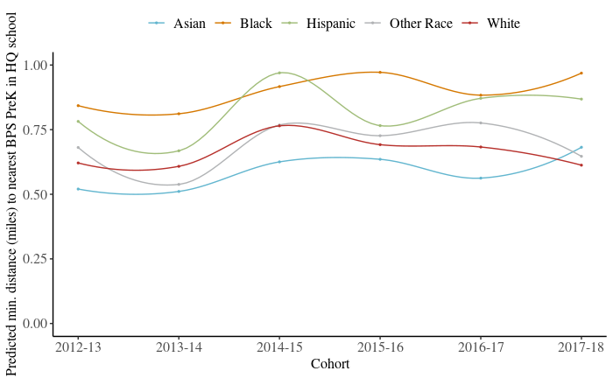
RQ 2: Changes in proximity to nearest PreK in higher-quality school by race and ethnicity

Slide 21
RQ 3: Does greater proximity to PreK promote more equitable enrollment patterns?
Proximity to the nearest BPS PreK program
Students who lived further away from a school offering the BPS PreK program were more likely to enroll in the program in general (OR = 1.35, p < .001), controlling for demographic characteristics and study year.
Compared to White students, when Black and Hispanic students lived further away from any BPS PreK program they were actually slightly more likely to enroll in one.
Proximity to nearest BPS PreK program in a high-quality school
Students who lived further away from the nearest program in a higher-quality school were less likely to enroll in a program in a higher-quality school.
Compared to monolingual English speaking students, when DLL students lived further away from a program in a higher-quality school they were more likely to enroll.
Notes:
Students who lived .25 miles from a PreK program in a higher-quality school had, on average, a 16% probability of enrolling in a program in a higher-quality school compared to students who lived 1 mile away and had a 6% probability of enrolling.

Slide 22
Summary of findings
Race and ethnicity matter for enrollment in prekindergarten & high-quality prekindergarten in the context of universal eligibility
Although access to programming has increased, disparities in access by race/ethnicity have also increased – critical to disaggregate data
Proximity on its own doesn’t necessarily relate to greater access; availability of quality programs is critical
Black and Hispanic students face structural challenges to enrolling – proximity to high-quality programs

Slide 23
Implications and directions for future research
May be particularly important to focus on disparities by race/ethnicity and intersection between race and income
Structural factors like proximity make a difference but consideration of alternative options and family preferences is critical – investigate how families rank choices to unpack these mechanisms
Need further information on how parents are making enrollment decisions to design interventions to promote equity; opportunities for systematic interventions using behavioral approaches

Slide 24
Paper is now published at AERA Open with open access
McCormick, M., Pralica, M., Hsueh, J., Weiland, C., Weissman, A. K., Shapiro, A., ... & Sachs, J. (2023). Going the Distance: Disparities in Pre-K Enrollment in Higher-Quality Schools by Geographic Proximity, Race/Ethnicity, Family Income, and Home Language. AERA Open, 9, 23328584231168867.

Slide 25
Thank you to our team!
MDRC
Marissa Strassberger
Rama Hagos
Sharon Huang
Desiree Alderson
Ilana Blum
Samantha Xia
Jennifer Yeaton
Mirjana Pralica
BPS
Brian Gold
Annie Taylor
Abby Morales
Marina Boni
Melissa Luc
David Ramsey
BPS Dept. of Early Childhood Staff
University of Michigan
Deborah Ball
Lillie Moffett
Paola Rosado
Amanda Ketner
Harvard
Sibyl Holland
Maia Gokhale
Data collection team

Slide 26
Funding Acknowledgment
The research reported here was supported by the Institute of Education Sciences, Department of Education, through Grant R305N160018 – 17 to MDRC and by the Robert Wood Johnson Foundation.
The opinions expressed are those of the authors and do not represent views of the Institute or U.S. Department of Education.

Slide 27
ADDITIONAL SLIDES/INFORMATION

Slide 28
Data sources for the current study
PreK & K enrollment & demographic data
Provided by the district from Fall 2012 – Fall 2018
Neighborhood locations and family proximity to PreK
Publicly-available Census and ACS data + student-level geocode data from BPS district + building off prior work (Shapiro et al., 2019)
School quality and charact.
Publicly available school-level data with test score information used to define high-quality

Slide 29
Research question 1 analytic approach: Linear probability models and logistic regression with clustered SEs
$${Enrollment}_{ij}=α_{1}+β_{1}{FRPL}_{ij}+β_{2}{DLL}_{ij}+β_{1}{Asian}_{ij}+β_{1}{Black}_{ij}+β_{1}{Hispanic}_{ij}+β_{1}{OtherRace}_{ij }+{χChild}_{ij}+{υYear}_{j}+ ε_{ij}$$
logit{Pr(y_{ij} = 1|χ_{ij})} = $α_{1}+β_{1}{FRPL}_{ij}+β_{2}{DLL}_{ij}+β_{1}{Asian}_{ij}+β_{1}{Black}_{ij}+β_{1}{Hispanic}_{ij}+β_{1}{OtherRace}_{ij }+{χChild}_{ij}+{υYear}_{j}+ ε_{ij}$

Slide 30
Differential access to prekindergarten & high-quality prekindergarten from 2012 – 2018 by race/ethnicity, family income, and DLL status
 |  | Enrolled in BPS prekindergarten |  |  | Enrolled in prekindergarten in high-quality school
 |  | b |  | SE | b |  | SE
Intercept |  | 0.54 | *** | 0.01 | 0.25 | *** | 0.01
Cohort (reference is 2012 - 2013)
 | 2013 - 2014 | 0.05 | *** | 0.01 | 0.01 |  | 0.01
 | 2014 - 2015 | 0.09 | *** | 0.01 | -0.01 |  | 0.01
 | 2015 - 2016 | 0.08 | *** | 0.01 | 0.03 | *** | 0.01
 | 2016 - 2017 | 0.07 | *** | 0.01 | 0.03 | *** | 0.01
 | 2017 - 2017 | 0.12 | ** | 0.01 | 0.02 | *** | 0.01
Student female |  | -0.02 | *** | 0.01 | 0.00 |  | 0.00
Student age on Sept. 1st (centered) |  | 0.08 | *** | 0.01 | 0.02 | *** | 0.01
Student race/ethnicity
 | Asian | -0.10 | *** | 0.02 | -0.05 | *** | 0.01
 | Black | -0.12 | *** | 0.01 | -0.17 | *** | 0.01
 | Hispanic | -0.12 | *** | 0.01 | -0.14 | *** | 0.01
 | Other race | -0.04 |  | 0.03 | -0.09 | *** | 0.02
DLL |  | 0.06 | *** | 0.01 | -0.01 | * | 0.00
Eligible FRPL |  | -0.01 |  | 0.01 | -0.05 | *** | 0.00

Slide 31
Proximity is related to enrollment in a school in a high-quality prekindergarten
Prekindergarten
Prekindergarten in high-quality school
Predictor |  | Coefficient (diff. enrollment in %) |  | SE
Intercept |  | .54 | *** | .01
Race/ethnicity (ref. group White)
 | Asian | -0.10 | *** | 0.01
 | Black | -0.11 | *** | 0.01
 | Hispanic | -0.12 | *** | 0.01
 | Other race | -0.03 | *** | 0.02
DLL |  | 0.06 | *** | 0.01
Eligible FRPL |  | -0.01 |  | 0.01
Female |  | -0.02 | ** | 0.01
Child age |  | 0.08 | *** | 0.01
Cohort (reference group Cohort 1)
 | Cohort 2 | 0.05 | *** | 0.01
 | Cohort 3 | 0.09 | *** | 0.01
 | Cohort 4 | 0.08 | *** | 0.01
 | Cohort 5 | 0.03 | *** | 0.01
 | Cohort 6 | 0.05 | *** | 0.01
Distance to nearest school (in miles) |  | 0.03 |  | 0.02
Coefficient (diff. enrollment in %) |  | SE
0.18 | *** | 0.04
-0.06 | *** | 0.01
-0.14 | *** | 0.01
-0.13 | *** | 0.01
-0.08 | *** | 0.02
-0.01 | † | 0.00
-0.05 | *** | 0.00
0.00 |  | 0.00
0.02 | *** | 0.01
0.00 |  | 0.01
0.01 |  | 0.01
0.03 | *** | 0.01
0.04 | *** | 0.01
0.05 | *** | 0.01
-0.09 | *** | 0.00

Slide 32
Research question 2 analytic approach: OLS regression with clustered SEs
$${DistanceClosestPreK}_{ij}=α_{1}+β_{1}{FRPL}_{ij}+β_{2}{DLL}_{ij}+β_{1}{Asian}_{ij}+β_{1}{Black}_{ij}+β_{1}{Hispanic}_{ij}+β_{1}{OtherRace}_{ij }+{χChild}_{ij}+{υYear}_{j}+ ε_{ij}$$
Used geocodes and addresses of schools to calculate distance measures between each student in the dataset and the distance to the closest BPS prekindergarten program (including CBOs) and the closest program in a high-quality school. This indicator represents the outcome in the analysis.

Slide 33
Sensitivity analyses and robustness checks
Fit models in full sample and compare with analysis sample
Restrict analyses to only students who enrolled in BPS kindergarten (similar to prior work)
Examining demographic predictors separately rather than in a fully-controlled model
Examining application to BPS prekindergarten rather than enrollment
Consider distance measures for programs actually enrolled in

Slide 34
Limitations of this research for disaggregating data to explore equitable access to PreK programming
Disaggregation highlights disparities but likely masks important variation across the district – more work is needed to unpack heterogeneity by systems and processes. Findings are non-experimental.
Disaggregation of data relies on BPS district’s strategy for operationalizing race and ethnicity; grouping students in this way creates neat but likely inaccurate categories and masks critical variation in experiences.
Need to consider alternative school quality measures as test scores can be problematic indicators and really reflect the income of the students who attend the school.

Slide 35
Increasing Early Childhood Education Applications through Targeted Outreach
Lindsay Weixler, Tulane University
Jon Valant, Brookings Institution
Justin Doromal, Urban Institute
Alica Gerry, Tulane University
This project was supported by the Robert Wood Johnson Foundation.

Slide 36
The ECE Enrollment Gauntlet
Accessing public early childhood education (ECE) is a complex, multistep process:
Pick programs
Apply
Verify eligibility
Enroll
Project Goal:
Increase the rate at which families apply for public ECE in New Orleans

Slide 37
Project Setting: New Orleans, LA
Centralized district application for all publicly funded ECE programs
State PK, city- and state-funded childcare seats, Head Start/EHS
Application Main Round for Fall 2022 seats: Nov 2021 – Jan 2022
Online application and verification system
Lottery-based match process
Followed by open enrollment for remaining seats and waitlists
Notes:
Many eligible children do not apply, or apply late. Prior work with NOLA-PS shows that simple text message reminders are effective at helping families get through the process.

Slide 38
Part 1: Information Campaign, July – Oct 2021
Ads ran on local agencies’
social media accounts and
through text blasts
Notes:
>1,000 responses, most effective posts were on the city’s social media pages.

Slide 39
Part 2: Text-Message RCT, Dec 2021 – Jan 2022
Sample: 1,178 families with an age-eligible child in the district’s contact database (from campaign or prior application)
Control Group: No text messages about new application for 2022-23
Treatment Group: Up to 2 text messages with a reminder about the upcoming application, link to district page, and invitation to chat with district staff

Slide 40
Text Messages Increased Application Rates

Slide 41
Conclusions
Lack of information presents a real barrier to ECE access.
Our findings highlight the multistep nature of the process - each step might require its own type of support.
Eliminating, consolidating, or simplifying steps on the P-A-V-E pathway might result in fewer families missing out on seats.
Notes:
ECE/district leaders should not assume families are aware of ECE enrollment processes and deadlines.

Slide 42
Thank you!
Lindsay Weixler lweixler@tulane.edu / @LBellWeixler

Slide 43
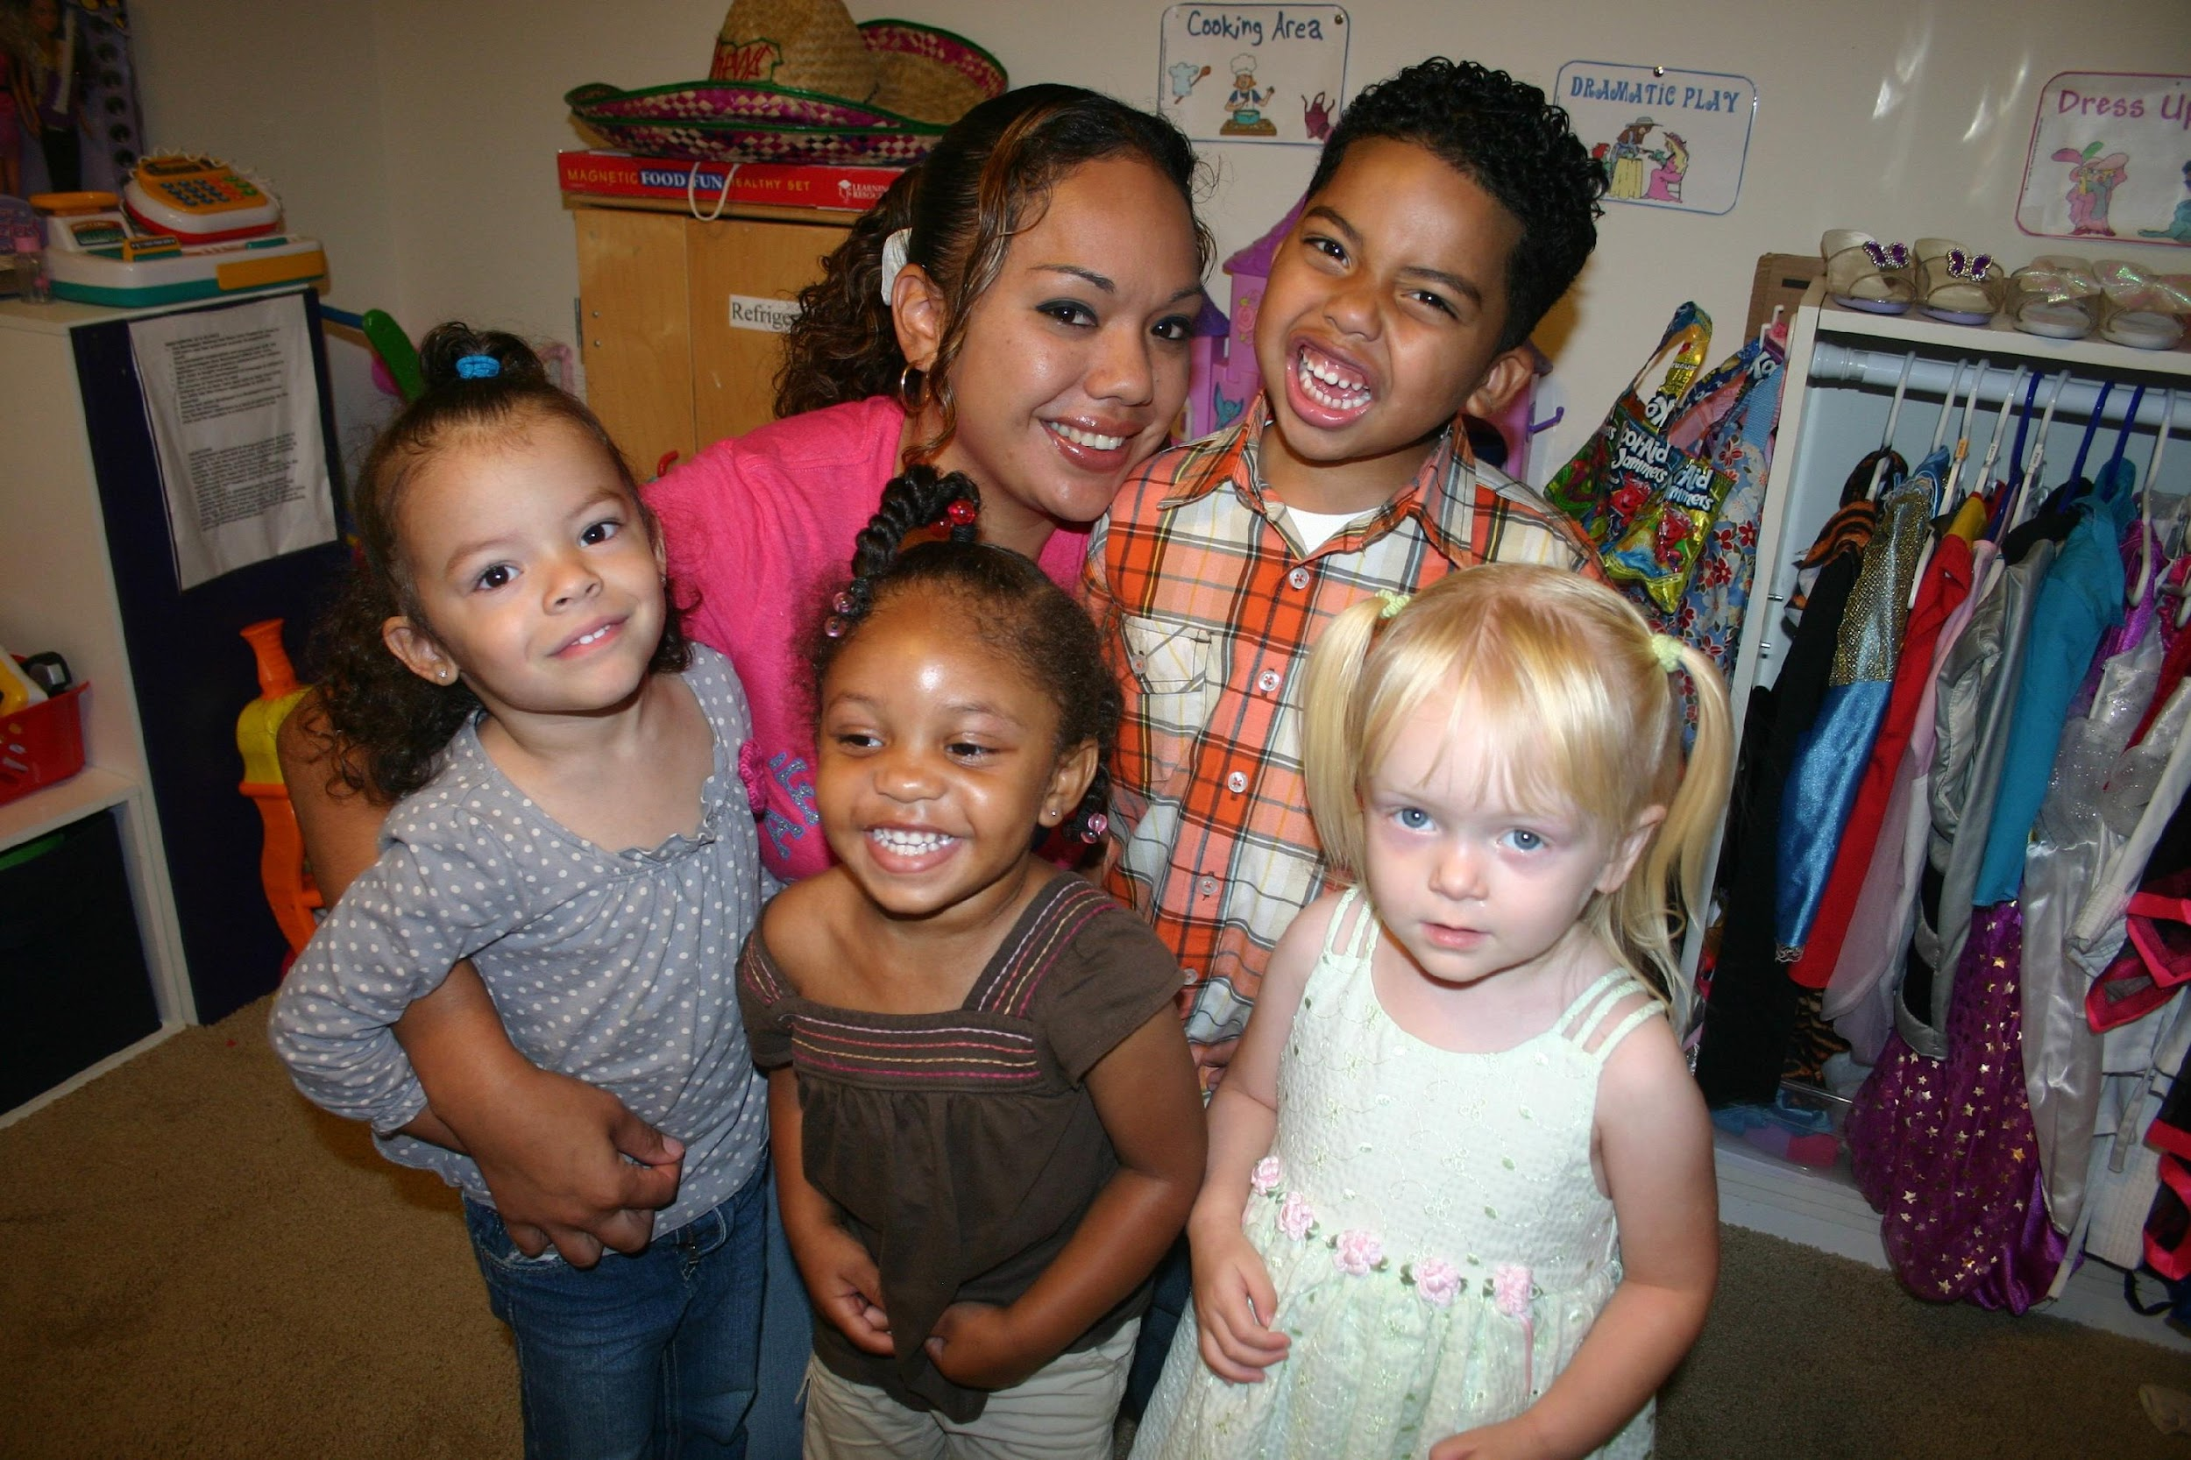
Effects of A Business Management Course on Child Care Providers’ Outcomes:
A Randomized Controlled Trial
Songtian (Tim) Zeng Ph.D. BCBA
Anne Douglass Ph.D
Yujin Lee Ph.D

Slide 44
Introduction
Childcare supply shortage: more prevalent in communities of color, immigrant communities, communities in areas of concentrated poverty, and rural communities (Jessen-Howard et al., 2018).
The fragility of the child care business model and financing is one of the primary reasons for the permanent closing of many ECE programs (Stoney & Blank, 2011).
Business skills training, financial management coaching, and technical support can improve the sustainability of ECE programs (Porter & Bromer, 2020).

Slide 45
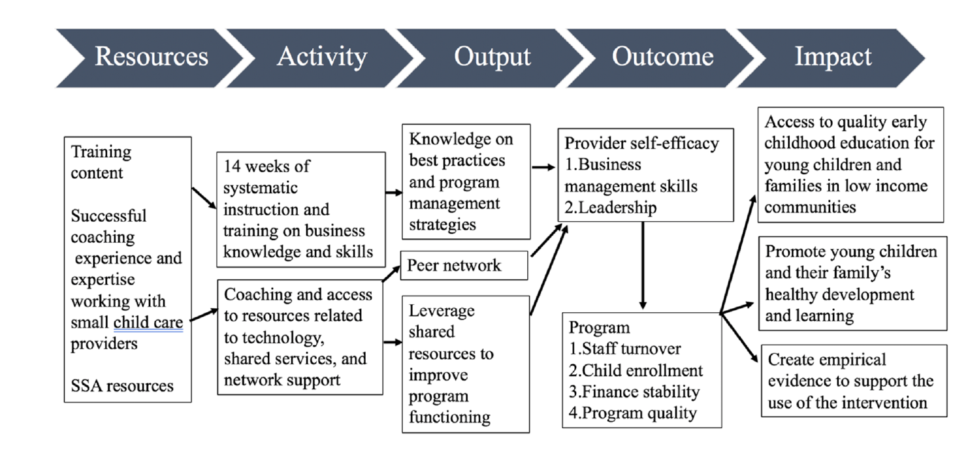
Theory of Change

Slide 46
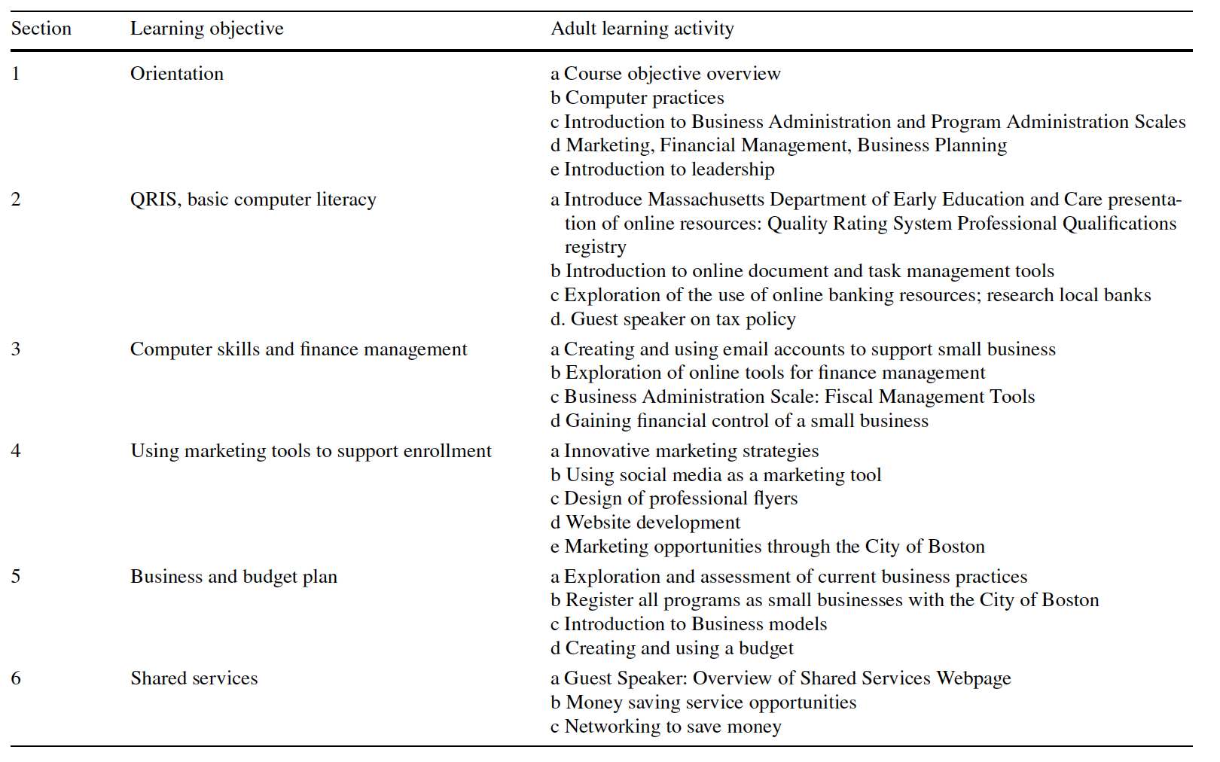
Small Business Innovation Course （SBIC）
Small Business Innovation Course （SBIC）

Slide 47
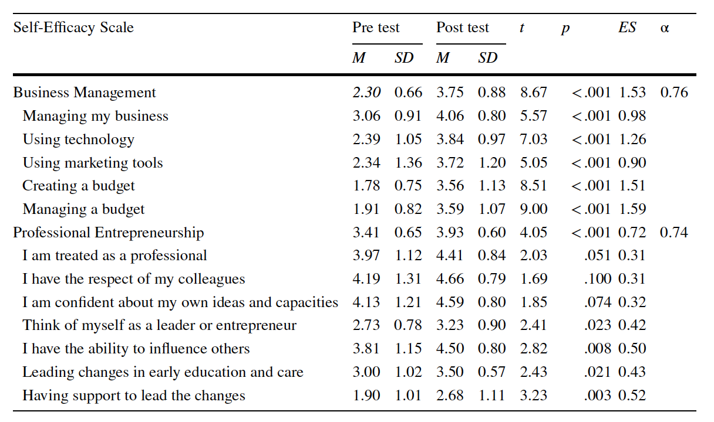
Knowledge Gap
Considerably little attention has been devoted to supporting ECE leaders’ business knowledge and skills (Stoney & Blank, 2011)
Efficacy from the pilot study (Zeng et a., 2019)
“I started to organize myself a little more with my finances, to seek resources to increase my income and to capture more so that I can make myself known.”
---Quote from a SBIC participant

Slide 48
What is the effect of SBIC intervention group on participants’
Research Questions
business management skills
confidence in business practices
access to business support
leadership efficacy compared to the control group

Slide 49
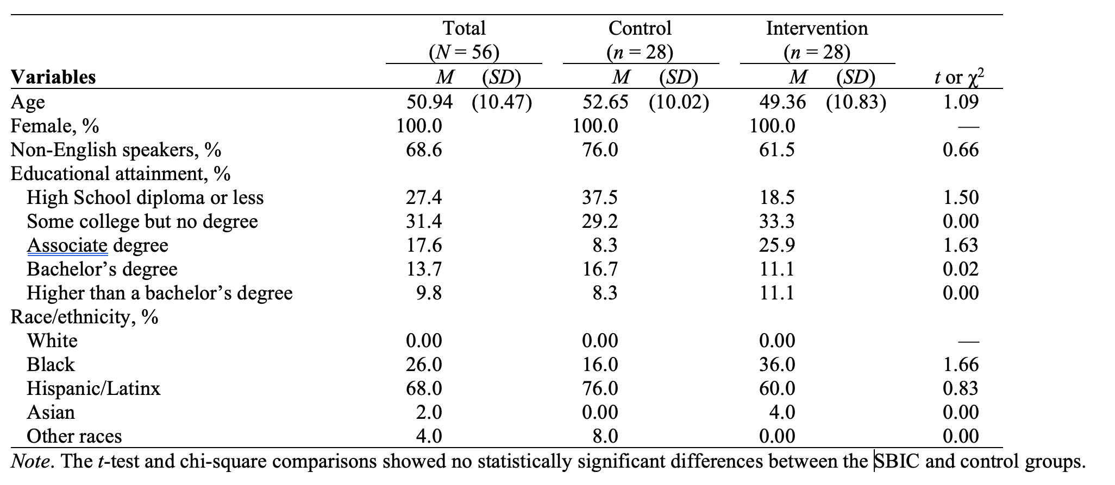
Methods
Research Design: waitlist randomized control trial
Participants: (a) served low-income communities; (b) operated in areas known for having a short supply of ECE services; (c) over 50% of enrollment are children of color; (d) struggled with managing their business and maintaining program quality, and e) had not previously participated in

Slide 50
Methods
Methods
Data collection: pre-post measure for both the treatment and control groups
Measures: perceived business management skills, confidence in business practices, access to business support, and leadership efficacy (α range: 0.74-0.97)
Data analysis:
Descriptive analysis (t-tests and chi-square tests)
ANCOVA to evaluate the effectiveness
Generalized eta squared (η²_{g}) was used for the effect size statistics
All data analyses were done using R (R Core Team, 2020)

Slide 51
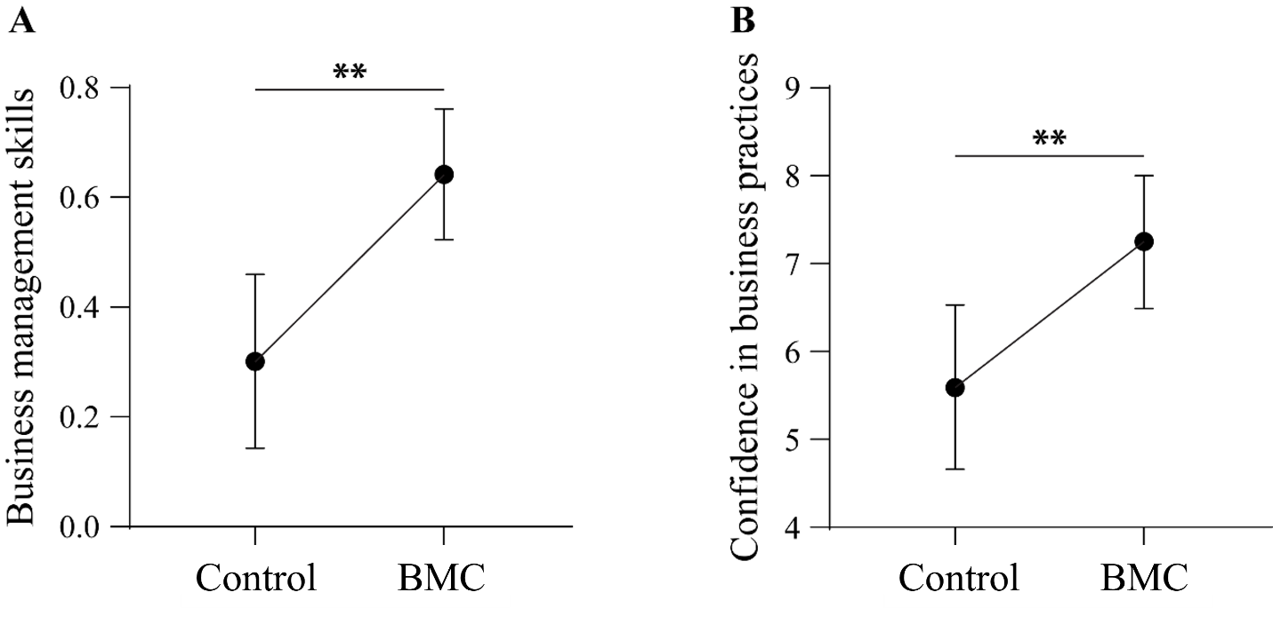
Results
sig：business management skills（ES=0.27）
& confidence in business practices （ES=0.21）
no significant group differences were found regarding participants’ access to business support and leadership efficacy
SBIC
SBIC

Slide 52
the first RCT study to test the effectiveness of business training specific to the ECE context.
showed the effectiveness of the SBIC on ECE leaders’ perceived business management skills and confidence in business practices.
access to business support and leadership efficacy did not vary between the SBIC and control groups. One plausible explanation is that gaining access to business support systems and developing leadership may take longer than the 14-week window. Another explanation might be that the learning activities of the SBIC intervention appeared more focused on business knowledge and skills than leadership.
limitation: assess the long-term effects; measurement
Discussion

Slide 53
Implication
Policy makers should devote more resources and on-going training opportunities to ECE providers serving high-poverty communities to support strong and sustainable business practices that are the foundation for high quality ECE.
Professional development activities for the ECE business owners should utilize adult learning activities that are relevant, hands-on, and focused on practical issues and building support networks that can promote sustained improvement.
Group based interventions offer distinct benefits, such as reducing service costs, capitalizing on the power of group process, promoting peer interaction, and creating safe spaces for skills learning and generalization.

Slide 54
Accessing High Quality Early Childhood Education during Illinois’ Public Act
Sarai Coba Rodriguez, PhD, CFLE
Human Development & Learning
Kate Zinsser, PhD
Community and Applied Psychology

Slide 55
Introduction
Vestibulum congue
State Policy Implementation
Public preschool expulsions happen at a rate three times that of K-12 settings (Gilliam, 2005; Zinsser et al., 2022).)
Illinois Public Act 100-0105: most expansive piece of EC expulsion legislation in the nation.
Less than 10% of studies attend to families’ experiences (Zinsser et al., 2022).
Families are the beneficiaries of the law.
Vestibulum congue
Vestibulum congue
Impact of Expulsion on Families
Program responses to children’s behavior
Early Childhood Expulsion
Vestibulum congue
Vestibulum congue
Unique challenges for foster-involved and children with disabilities
Subsequent Care Arrangements

Slide 56
Research Questions
How do families experience exclusions prior to and following the passage of the Illinois expulsion ban and do planned transitions occur as stipulated after 2018?
How do parents’ experiences of programs’ responses to children’s challenging behaviors differ following the passage of the expulsion ban with regards to communication, documentation, and resources and supports provided?
For what types of behaviors are children ultimately excluded prior to and following the law?

Slide 57
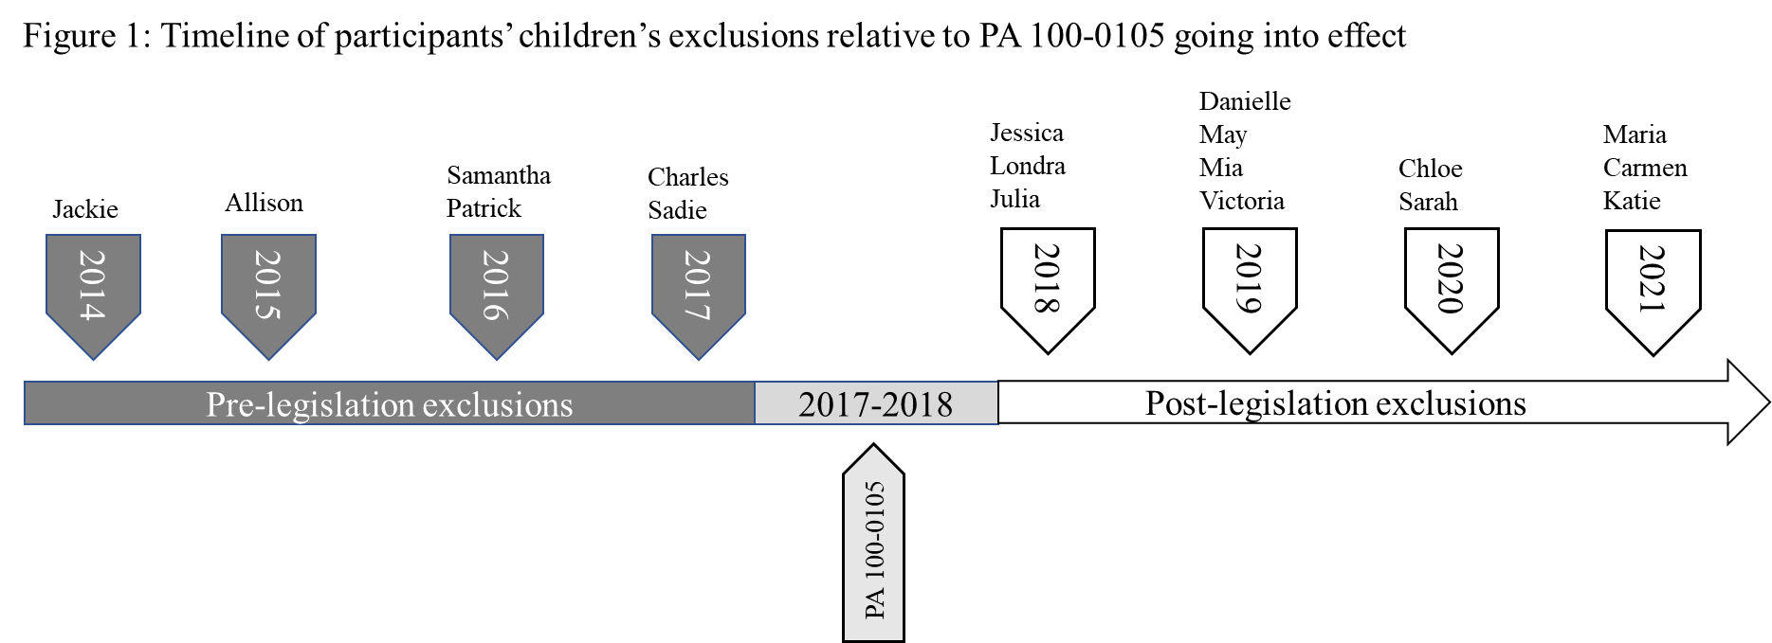
“He was out of control-he was overstimulated, and they took him to the office, and he was continuing to be out of control, and [the director] said, ‘Liam you need to calm down or we’re going to have to call the police on you and the police are going to have to come down here.”
Charles, Liam’s Dad
“They did nothing. They just said our kid’s not a good fit. They were not going to make any changes to anything that they did or any way they did anything.”
Chloe, Gavin’s Mom
Exclusions continued, despite passage of law
Externalizing behaviors & developmentally appropriate non-compliance both cited as justifications before and after the law
Similar content, format and frequency of communication.
Engagement of resources/supports was limited and outsourced to families post-legislation
Notes:
To the best of our knowledge, this qualitative comparison of the experiences of families excluded prior to and following the Illinois expulsion ban, PA 100-0105, is the only study to utilize parent data to evaluate expulsion policy implementation. Our study yielded several key findings. Firstly, it is notable that exclusions continued to occur in the years following the ban’s implementation and no families in our sample, regardless of timing, described experiencing the planned transition stipulated in the law. The ways in which and frequency with which programs communicated with families about their children’s behavior was nearly equivalent across groups. Parents in both groups received frequent informal verbal updates but they differed in perceived urgency. Fewer families received formal incident reports before the law went into effect than after. Most, but not all families in both groups, had formal meetings with the program but these tended to immediately precede the exclusion and focused on justifying the child’s exclusion rather than seeking collaborative solutions. Children excluded after the law went into effect appear to have accessed a variety of behavioral resources, but parents were the driving force behind acquiring such supports. Finally, while many children were excluded for displaying externalizing behaviors, those excluded following the ban were also commonly excluded for developmentally appropriate non-compliance (e.g., struggling to share), and parents received messaging that their child’s behaviors were an inconvenience for staff. While these data were collected in a unique context, the situations described by these families are not exclusive to Illinois. In this discussion we will further describe these findings and identify possible next steps and recommendations for advocates, policymakers, and professionals working with or on behalf of young children and families.

Slide 58
Implications for Policies / Programs
Greater education & communication for parents and providers about state-wide viable and evidence-based interventions and resources
Effective teacher techniques for managing and redirecting unwanted behaviors
Changes in the structure and working conditions of ECE teachers
Expanding and utilizing IECMHC
Findings ways to support program’s vulnerability and proactive help-seeking

